Slide 1
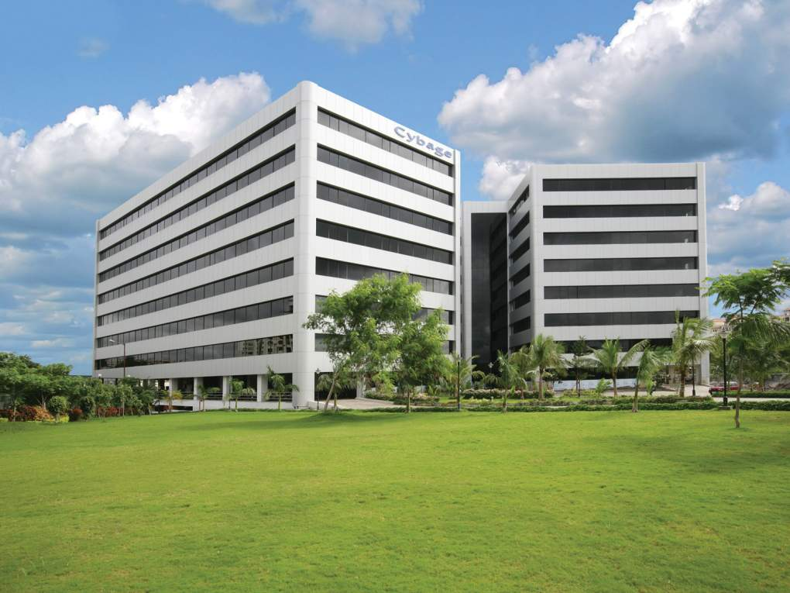

Welcome to Cybage
This document and all its contents contain information from Cybage Software Private Limited which may be privileged, confidential, or otherwise protected from disclosure. The information is intended to be for the addressee(s) only. Any unauthorized disclosure, copy, distribution, or use of the contents of this message is strictly prohibited.

Slide 2
Authored and Presented by : Abhishek Bhatnagar

Slide 3
Agenda
What is DevOps?
What is Configuration Management?
Before and After Introduction of Puppet
What is Puppet?
Infrastructure As A Code
History
Features
Architecture
System Requirements and Installation
Benefits and Cons
References

Slide 4
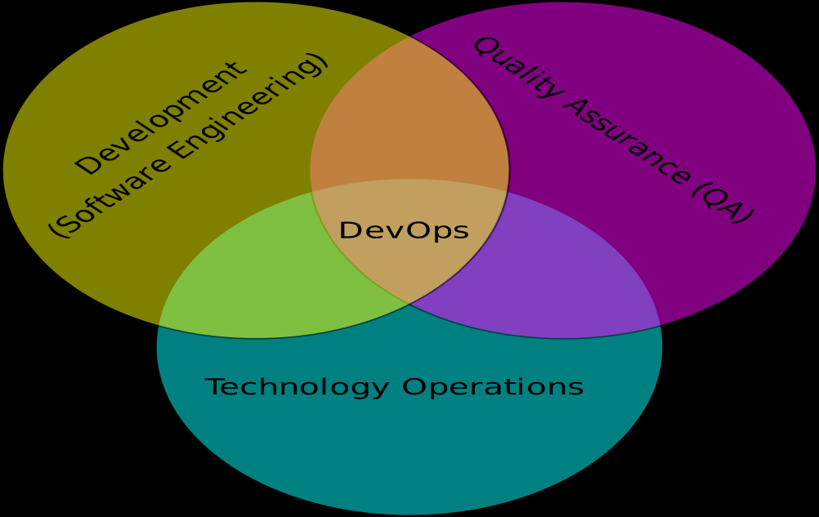
DevOps
Development + Operations = DevOps
It’s a concept dealing with software development, operations, and services.
It emphasizes communication, collaboration, and integration between software developers and information technology (IT) operations personnel.

Slide 5
Configuration Management
Configuration management is the process of configuring machines/servers/virtual machines,etc in order to bring them under desired software specifications and enforcing their state across IT infrastructure in an automated yet agile manner.
Configuration Management is the art of identifying, organizing and controlling modifications to the software being built by a programming team.
Goal is to maximize productivity by minimizing mistakes arising due to manual operations.

Slide 6
Before & After Introduction of Puppet
Before Puppet
After Puppet
PuppetMaster
Shell script
Machine A
Shell script
Machine B
Puppet Agent
Puppet Agent
Shell script
Machine C
Puppet Agent

Slide 7
Puppet – Configuration Management tool
Configuration management tool.
Automates the configuration management and report generation.
User interface is simple, intuitive, and visually appealing.
Easy to install and use.
Can be used with CI servers to achieve Continuous Deployment.
Implemented in Ruby.
Puppet enables Infrastructure As A Code.

Slide 8
Infrastructure As A Code
Programmatically provision and configure an infrastructure.
We capture the requirement for our infrastructure and try to create/implement that infrastructure by writing code.
A program ensures each node in our infrastructure compiles with the requirement.
A control loop keeps the system stable and allows for change when requirement is updated.
Reconstruct business from code repository, data backup, etc.

Slide 9
History
Puppet – History
2001 - Luke Kanies began developing tool in 2001.
2005 – Puppet Labs was founded by current CEO Luke Kanies.
Investors include Cisco, Google Ventures, Vmware, Kleiner Perkins Caufield & Byers, Triangle Peak Ventures, etc.

Slide 10
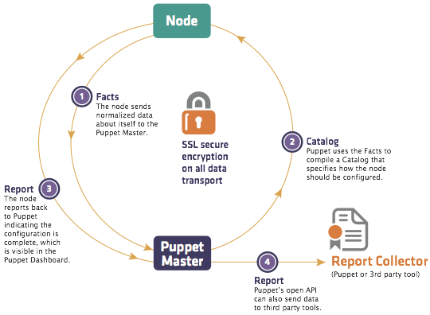
Architecture

Slide 11
Puppet Flavours
Puppet comes in 2 flavours – Puppet Enterprise and Puppet Open Source.
Features such as Puppet Enterprise Console, Live Management, Event Inspector, other third party tools etc. are not available with Puppet Open Source package.
Moreover, Puppet Enterprise entertains support from PuppetLabs community.

Slide 12
Puppet Implementation
Puppet can be implemented in 2 modes
Client-Server mode
Standalone mode
Client-Server mode
Puppet Master
Facts
Catalog
Puppet Client
Report

Slide 13
Puppet Terminologies
Manifests
Puppet programs are called “manifests,” and they use the .pp file extension.
The core of the Puppet language is the resource declaration. A resource declaration describes a desired state for one resource.
Manifests can also use various kinds of logic: conditional statements, collections of resources, functions to generate text, etc.
Example : Creating a file
file {'testfile':
path => '/tmp/testfile',
ensure => present,
content => "I'm a test file.",
}

Slide 14
Puppet Terminologies
Classes
A collection of related resources, which, once defined, can be declared as a single unit.
For example, a class could contain all of the elements (files, settings, modules, scripts, etc) needed to configure Apache on a host.
Classes can also declare other classes.
Example : A class for user creation
Class user_creation{
user{‘cybage’:
ensure=>present,
}
}

Slide 15
Puppet Terminologies
Catalog - A catalog is a document that describes the desired system state for one specific computer. It lists all of the resources that need to be managed, as well as any dependencies between those resources.
Modules – Modules are self-contained bundles of code and data. You can write your own modules or you can download pre-built modules from the Puppet Forge.
node ‘xyz.cybage.com’{ Node Classification
include java, Puppetlabs-java module
}

Slide 16
Puppet Terminologies
Fact
A piece of information about a node, such as its operating system, hostname, or IP address,etc.
Facts are read from the system by Facter, and are made available to Puppet as global variables.
Facter
Facter is Puppet’s system inventory tool.
Facter reads facts about a node (such as its hostname, IP address, operating system, etc.) and makes them available to Puppet.
Example - $facter
hostname => abhishekb-w8
ipaddress => 172.27.59.83

Slide 17
Puppet Implementation (contd.)
Puppet Client-Server Implementation advantages :-
All configuration source is centrally stored and managed on the puppet server.
The client doesn't have access to the source code, just the compiled catalog that applies to it.
The server allows for more complicated management of nodes using an external node classifier (like the dashboard).
Uses certificates to ensure that only authorized clients can retrieve configuration.

Slide 18
Puppet Implementation (contd.)
Puppet Standalone Implementation advantages :-
Smoke testing on individual nodes.
Removes the complexity of both compiling and waiting for the catalog to run at client’s machine.
Best way to learn puppet.
User don’t need to have knowledge of using a particular OS, puppet DSL is almost same for all OSs. Eg.
puppet apply -e "package {'bash': ensure => latest}“

Slide 19
Puppet Components
3 Components in Puppet Architecture
Deployment
Configuration Layer and RAL
Transactional Layer

Slide 20
Deployment
Master
Master
runs a daemon
listens on port 8140
serves a configuration catalog
Agents
Connects to master via SSL
connection
Retrieves any configuration from catalog
Can run as daemon or manually triggered
Agent 1
Agent 2

Slide 21
Configuration Language and RAL
Package {‘vim’:
ensure=>installed,
}
User {‘johny’:
ensure=>present,
password=>’******’
Configuration items are named resources.
Statements about the state of configuration.
Sysadmin doesn't care how this state is achieved.
Agents use Facter to get information about themselves.
Agents manage providers depending on system type.

Slide 22
Transactional Layer
The process of host configuration has these steps:
Compile the configuration
Transfer the compiled configuration to agents
Apply the configuration on agents
Report the results to the master

Slide 23
System Requirements
Hardware
The puppet agent service has no particular hardware requirements and can run on nearly anything.
The puppet master service is fairly resource intensive, and should be installed on a robust dedicated server.
At minimum, puppet master server should have two processor cores and at least 1 GB RAM.
To comfortably serve at least 1000 nodes, it should have 2-4 processor cores and at least 4 GB RAM.

Slide 24
PuppetMaster & Agent Installation on Different OS
Debian and Ubuntu:
apt-get install puppetmaster
apt-get install puppet
Red Hat:
yum install puppet-server
yum install puppet
Puppetmaster does not work on windows environment, though puppet agent can be installed on windows.
Puppet agent can also be installed on Mac OS x.

Slide 25
Directory Structure
Linux
By default puppet gets installed at /etc/puppet directory.
Puppet
Auth.conf
Environments/
Fileserver.conf
Manifests/
Modules/
Puppet.conf
SSL/

Slide 26
Configuration using Puppet
Puppet uses various resources to configure target machines.
File
Package
Notify
User
Group
Cron
Exec
Service
Note : There are 48 resources in total, above listed resources are most common among them.

Slide 27
Notify
Notify sends a message to the clients and will be saved to Puppet logs.
Example sends “Notification to the clients” and text to the logs.
Eg. Notify { ‘Notification to the client’ :}

Slide 28
File
With File resource you can control everything about files.
This example writes some data into /tmp/helloPuppet file.
Example
file { '/tmp/helloPuppet':
content => 'See you Later!\n'
}

Slide 29
Package
Package resource gives you management over installable packages.
In below example we are installing package via apt-get.
Example
package { ‘apache2':
ensure=>'installed'
}

Slide 30
Service
Service resource manages services running on the client for example Apache2.
The following example checks that Apache2 is running, if it’s not it will be started.
Example
service { 'apache2':
ensure=>'running‘
}

Slide 31
Exec
Exec resource as it’s name says executes something.
For example the following will apt-get update.
Example
exec { 'apt-get update':
path=>'/usr/bin/' ,
}

Slide 32
Cron
Cron creates and controls cron jobs in the system.
For example we can run logrotate every day at 05:00.
Example
cron { logrotate:
command=>'/usr/sbin/logrotate',
user=>root,
hour=>5,
minute=>0,
}

Slide 33
User
With User resource we can control users and mostly system users.
On the example we set users full name as comment to user .
Example
user { ’Ananya':
ensure=>present,
password=>’*****’,
}

Slide 34
Group
Group resource is made for managing groups and mostly creating them.
Example ensures the global.net -group exists. If it doesn’t, it will be created.
Example
group { ‘global.net':
ensure=>'present‘,
}

Slide 35
Benefits of Puppet
Highly configurable system
Additional community developed modules provides more flexibility
By combining Puppet with CI servers, Continuous Deployment can be achieved
Generate various configuration reports
Can be integrated with different Version Control Systems
Deploys directly to production or test environments
More Ops-friendly due to relatively small learning curve.

Slide 36
Any Questions?

Slide 37
Thank you!

